Slide 1

Suit Alternanza scuola-lavoro 2018/2019

Slide 2
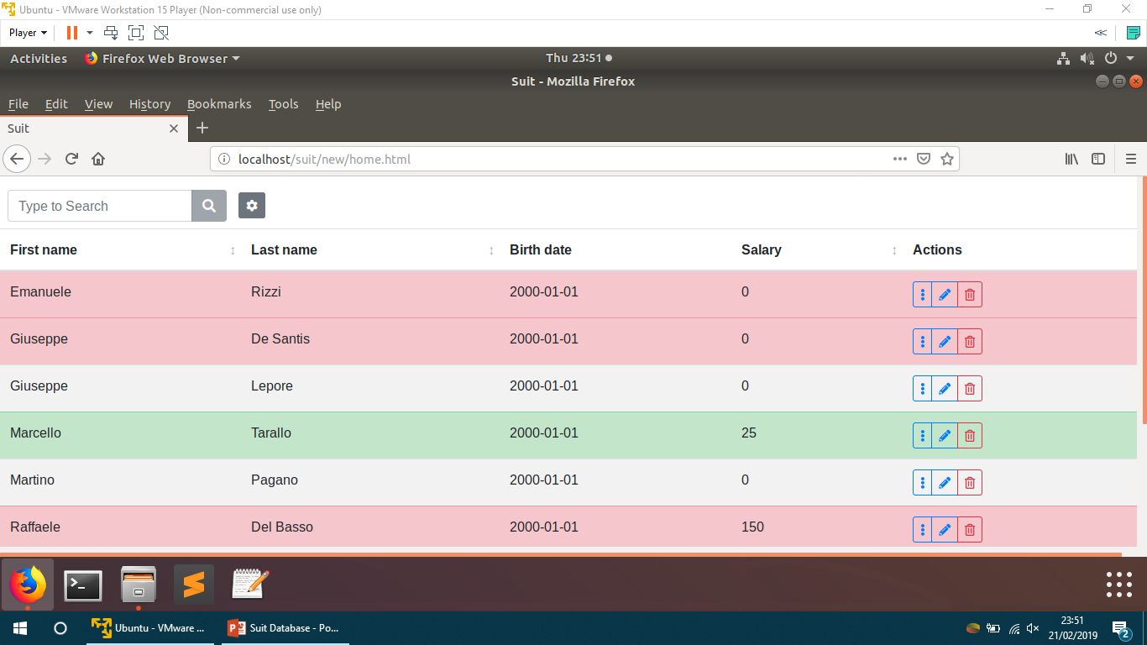

What is «Suit»?
Suit is our HR management web app that aims to simplify the process of finding and hiring potential candidates employees,
.

Slide 3








How is it made?
Back-end
Front-end

Slide 4
How does it work?
The software has a top section which contains the search bar and the filter panel, and the main section which shows the candidates in a table.

Slide 5
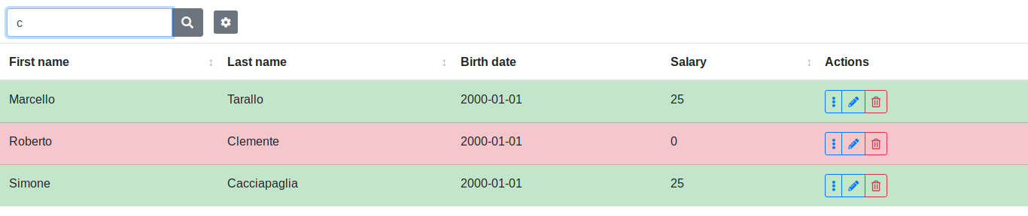
Search and filters • Search bar
The search bar allows you to search for a candidate by first name and last name using the incremental search method (case insensitive).

Slide 6
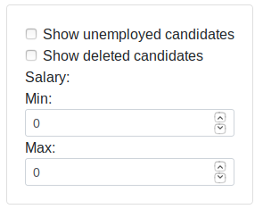
Search and filters • Filters
The following panel allows you to apply and combine filters in order to show specific candidates for a more detailed search.
Being modified

Slide 7
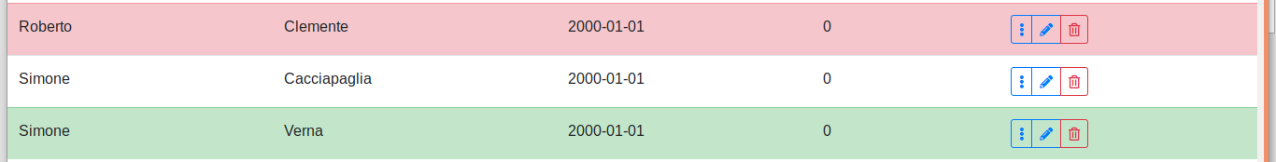
Rows and candidates
Deleted rejected(?) candidate
Non not -deleted and non not-employed candidate
Hired candidate (non si capisce se assunto da Lanit o attualmente occupato)

Slide 8
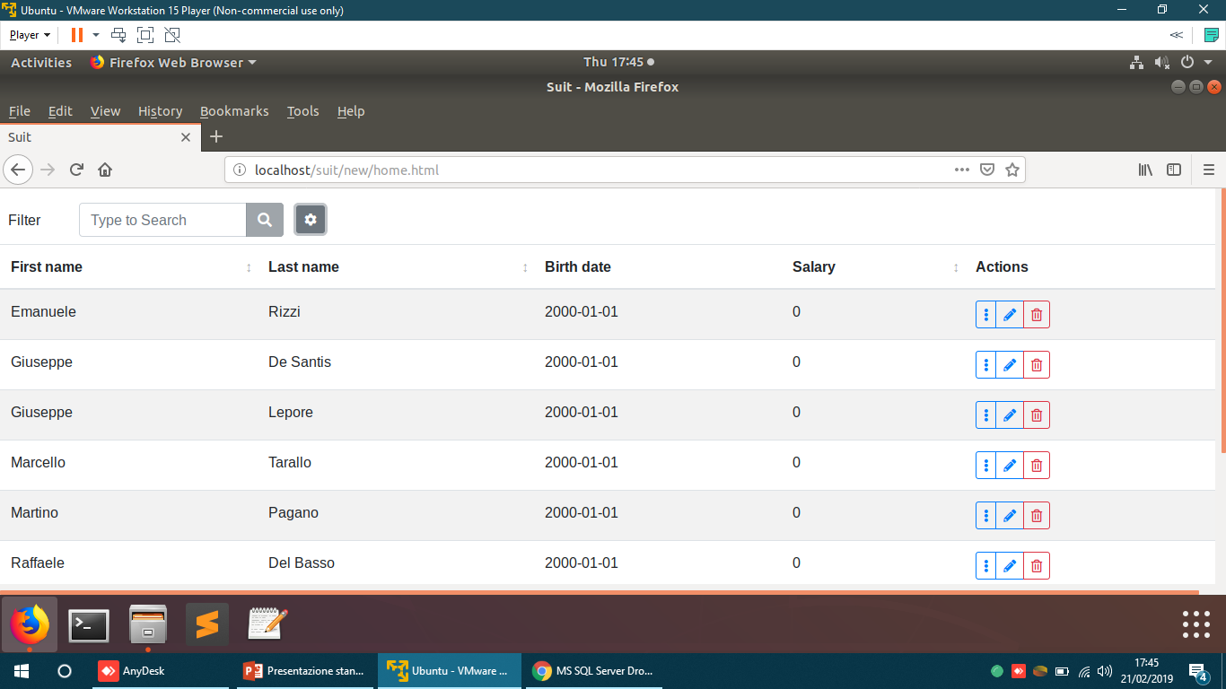
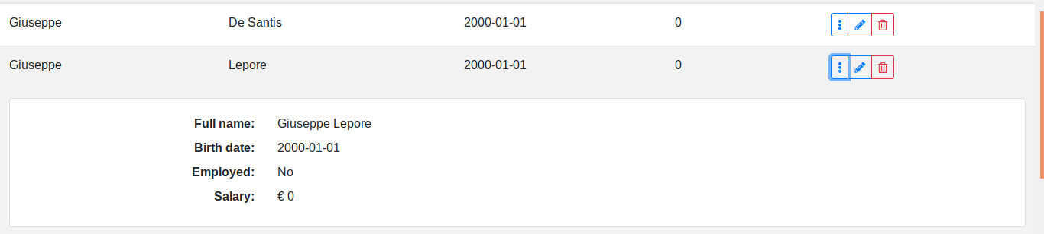
Action list • Details
This button allows you to see all the candidate information.
In the future there will be also coming soon:
Contacts;
Notes.
The row expands and shows the following information:
Full name;
Birth date;
Whether he/her is employed or not;
Salary.

Slide 9
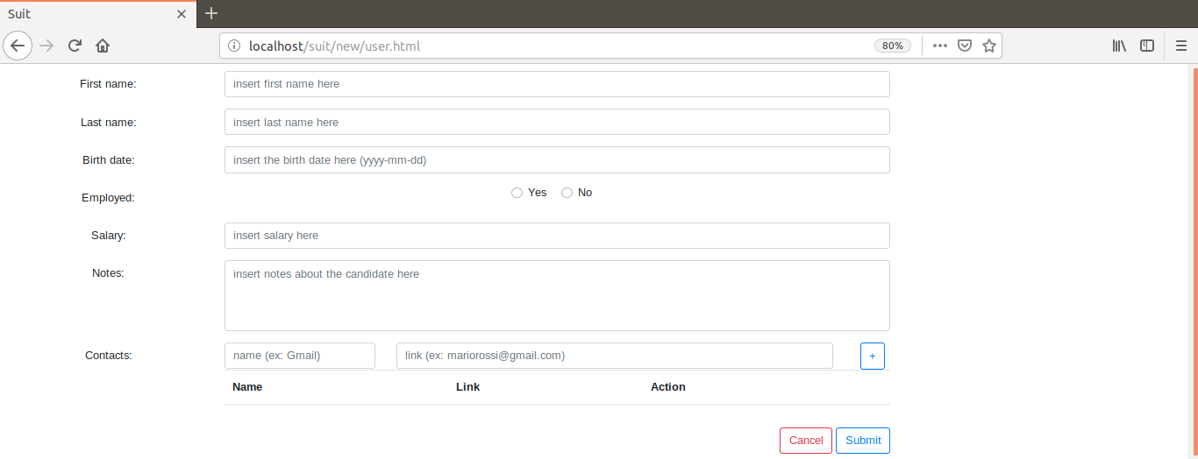
Action list • Candidate modification
This button lets you edit the candidate information.
Being implemented WHAT???

Slide 10
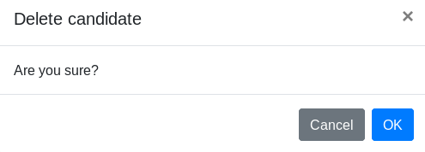
Action list • Candidate deletion
This button lets you delete the candidate. It will still be possible to see the deleted candidates through the filter panel.
Being implemented WHAT??

Slide 11
Conclusions
Therefore our software has the goal of to simplify the management hiring process of candidates for the company.
OPPURE
Our software has the goal to help the company with the hiring process.
Next implementations coming features:
Add, edit and remove a candidate;
Log-in system;
New filters.
The app might be updated in the future to allow to manage all the human resources employees becoming a more general tool for the company.
Aggiungete i link al progetto su github

Slide 12

Thank you for the attention.

Slide 13
BACKUP

Slide 14
DESCRIZIONI PIU’ TECNICHE: Ambiente utilizzato, control version tool ecc. ecc.

